Slide 1
Images and Pixels

Slide 2
pixels
Daniel Shiffman
A digital image is nothing more than data—numbers indicating variations of red, green, and blue at a particular location on a grid of pixels. Most of the time, we view these pixels as miniature rectangles sandwiched together on a computer screen. With a little creative thinking and some lower level manipulation of pixels with code, however, we can display that information in a myriad of ways. This tutorial is dedicated to breaking out of simple shape drawing in Processing and using images (and their pixels) as the building blocks of Processing graphics.

Slide 3
Your very first image processing filter
When displaying an image, you might like to alter its appearance. Perhaps you would like the image to appear darker, transparent, blue-ish, etc. This type of simple image filtering is achieved with Processing's tint() function. tint() is essentially the image equivalent of shape's fill(), setting the color and alpha transparency for displaying an image on screen. An image, nevertheless, is not usually all one color. The arguments for tint() simply specify how much of a given color to use for every pixel of that image, as well as how transparent those pixels should appear.

Slide 4
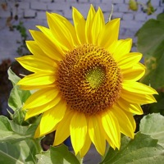
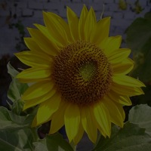
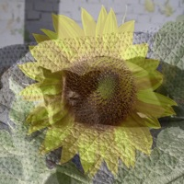
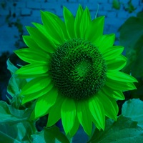
PImage sunflower = loadImage("sunflower.jpg"); PImage dog = loadImage("dog.jpg"); background(dog);
// The image retains its original state. tint(255); image(sunflower,0,0);
// The image is at 50% opacity. tint(255,127); image(sunflower,0,0);
// None of its red, most of its green, and all of its blue. tint(0,200,255); image(sunflower,0,0);

Slide 5
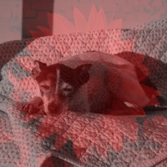
// The image is tinted red and transparent. tint(255,0,0,100); image(sunflower,0,0);

Slide 6
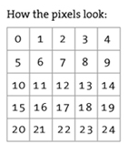

Pixels, pixels, and more pixels
We are familiar with the idea of each pixel on the screen having an X and Y position in a two dimensional window. However, the array pixels has only one dimension, storing color values in linear sequence.

Slide 7
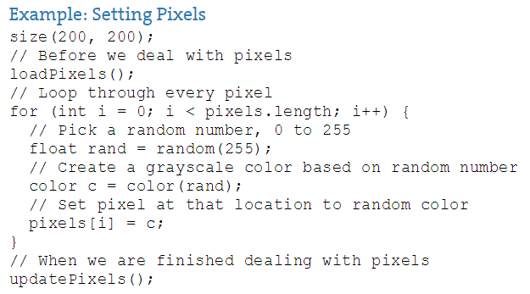
Example: Setting Pixels
loadPixels() This function is called before you access the pixel array, saying "load the pixels, I would like to speak with them!"
updatePixels() This function is called after you finish with the pixel array saying "Go ahead and update the pixels, I'm all done!"

Slide 8
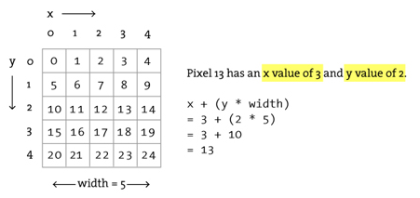
Assume a window or image with a given WIDTH and HEIGHT.
We then know the pixel array has a total number of elements equaling WIDTH * HEIGHT.
For any given X, Y point in the window, the location in our 1 dimensional pixel array is: LOCATION = X + Y*WIDTH

Slide 9
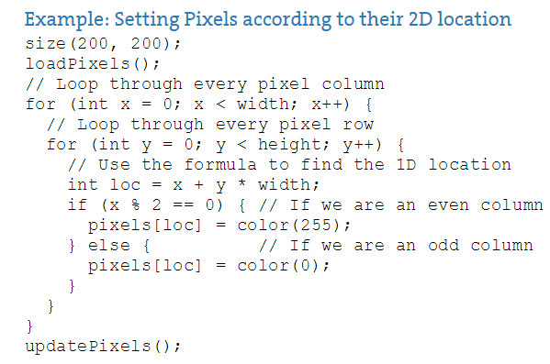
Example: Setting Pixels according to their 2D location

Slide 10
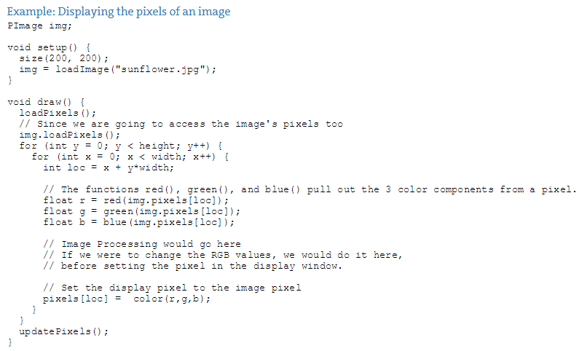
Intro To Image Processing
example 15-7 provides a basic framework for getting the red, green, and blue values for each pixel based on its spatial orientation (XY location)

Slide 11
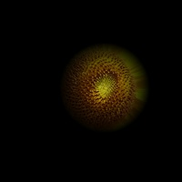
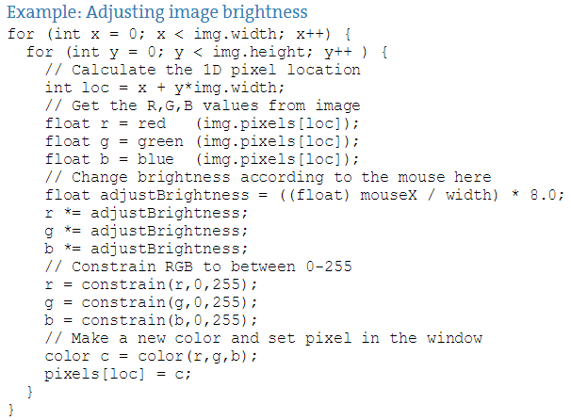
Example: Adjusting image brightness
Since we are altering the image on a per pixel basis, all pixels need not be treated equally. For example, we can alter the brightness of each pixel according to its distance from the mouse.

Slide 12
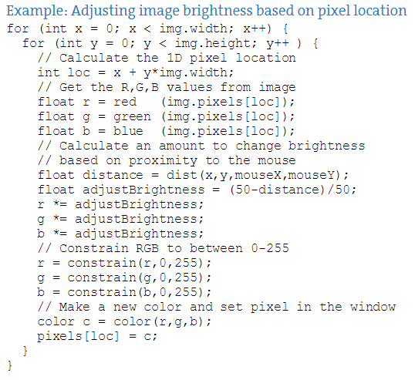
Example: Adjusting image brightness based on pixel location

Slide 13
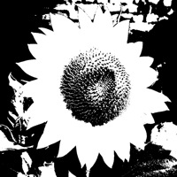
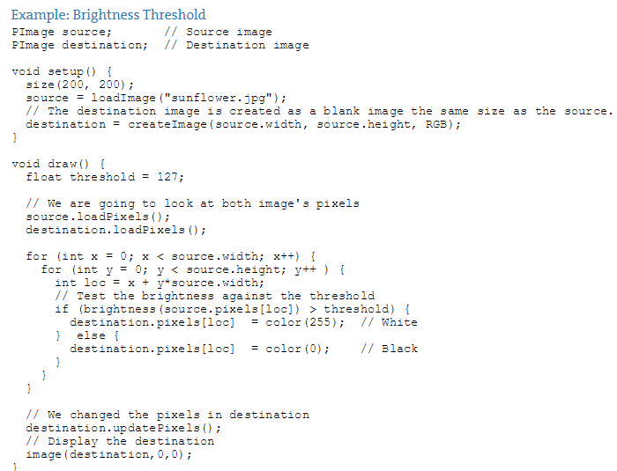
Example: Brightness Threshold

Slide 14
Level II: Pixel Group Processing
In previous examples, we've seen a one-to-one relationship between source pixels and destination pixels. To increase an image's brightness, we take one pixel from the source image, increase the RGB values, and display one pixel in the output window. In order to perform more advanced image processing functions, we must move beyond the one-to-one pixel paradigm into pixel group processing.

Slide 15
Level II: Pixel Group Processing
If we know the pixel is located at (x,y):
int loc = x + y*img.width;
color pix = img.pixels[loc];
Then its left neighbor is located at (x-1,y):
int leftLoc = (x-1) + y*img.width;
color leftPix = img.pixels[leftLoc];
We could then make a new color out of the difference between the pixel and its neighbor to the left.
float diff = abs(brightness(pix) - brightness(leftPix));
pixels[loc] = color(diff);

Slide 16
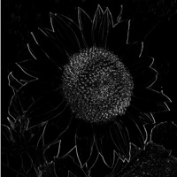
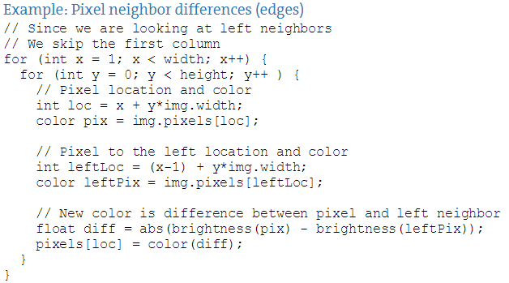
Example: Pixel neighbor differences (edges)
This example is a simple horizontal edge detection algorithm. When pixels differ greatly from their neighbors, they are most likely "edge" pixels. For example, think of a picture of white piece of paper on a black tabletop. The edges of that paper are where the colors are most different, where white meets black.

Slide 17
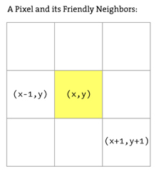
In the previous example, we looked at two pixels to find edges. More sophisticated algorithms, however, usually involve looking at many pixels at a time. After all, each pixel has 8 immediate neighbors: top left, top, top right, right, bottom right, bottom, bottom left, left.

Slide 18
A Sharpen& A Blur
These image processing algorithms are often referred to as a "spatial convolution." The process uses a weighted average of an input pixel and its neighbors to calculate an output pixel. In other words, that new pixel is a function of an area of pixels. Neighboring areas of different sizes can be employed, such as a 3x3 matrix, 5x5, etc.
Different combinations of weights for each pixel result in various effects. For example, we "sharpen" an image by subtracting the neighboring pixel values and increasing the center point pixel. A blur is achieved by taking the average of all neighboring pixels. (Note that the values in the convolution matrix add up to 1).

Slide 19
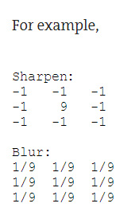
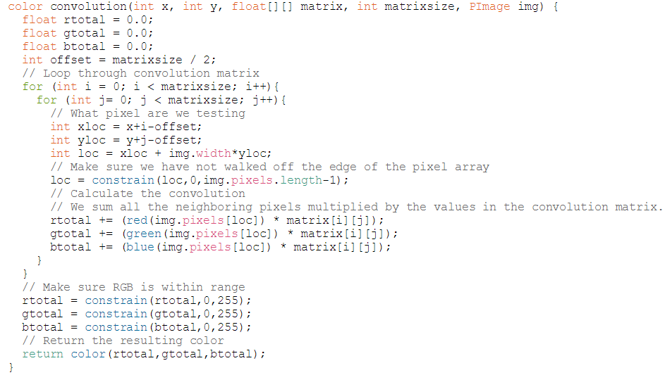
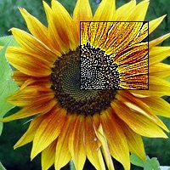
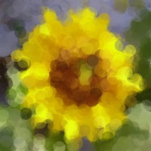
A Sharpen& A Blur

